Slide 1

WILL AN EMPLOYEE LEAVE THE ORGANIZATION?
Rawan Alamoud

Slide 2
TABLE OF CONTENTS
01.
02.
TOOLS
BUSINESS PROBLEM
DATASET
04.
05.
DATA MODEL
03.
FINDINGS
06.
RESOURCES

Slide 3
BUSINESS PROBLEM

Slide 4

Employee resignation is a major problem for many organizations and this could result in a loss of money, time, and effort for an organization.
I QUIT!
The purpose of this project is to build a classification model that helps the organization predict whether the employee will leave the organization or continue to work for it.

Slide 5
TOOLS

Slide 6
DATA PROCESSING
MODELING
VISUALIZATION
Numpy and pandas
Scikit-learn
Matplotlib and Seaborn

Slide 7
DATASET

Slide 8
HUMAN RECOURSES DATASET
Target
salary | Department | Promotion last 5 years | left | Work accident | Time Spend company | Average monthly hours | Number project | Last evaluation | Satisfaction level
low | sales | 0 | 1 | 0 | 3 | 157 | 2 | 0.53 | 0.38 | 0
medium | sales | 0 | 1 | 0 | 6 | 262 | 5 | 0.86 | 0.80 | 1
medium | sales | 0 | 1 | 0 | 4 | 272 | 7 | 0.88 | 0.11 | 2
low | sales | 0 | 1 | 0 | 5 | 223 | 5 | 0.87 | 0.72 | 3
low | sales | 0 | 1 | 0 | 3 | 159 | 2 | 0.52 | 0.37 | 4
The dataset contains 14,999 data points and 10 features.

Slide 9
FINDINGS

Slide 10
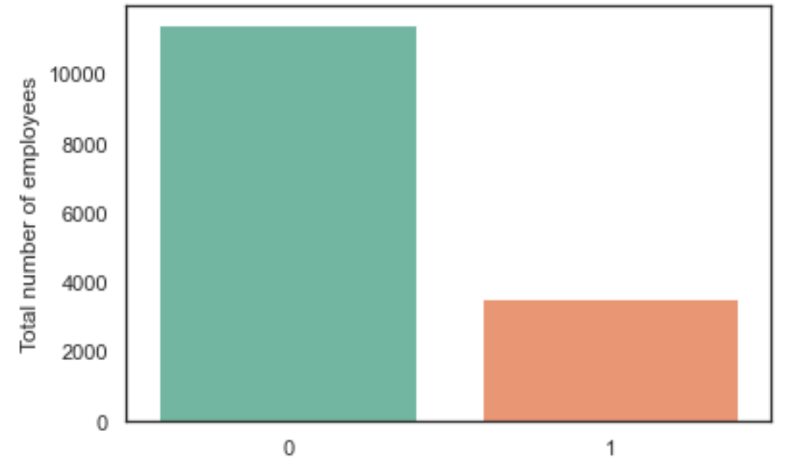
NUMBER OF EMPLOYEES CONTRACTED/LEFT
CONTRACTED EMPLOYEE
LEFT EMPLOYEE
The total number of employees who have left the organization: 3571
The total number of contracted employees: 11428

Slide 11
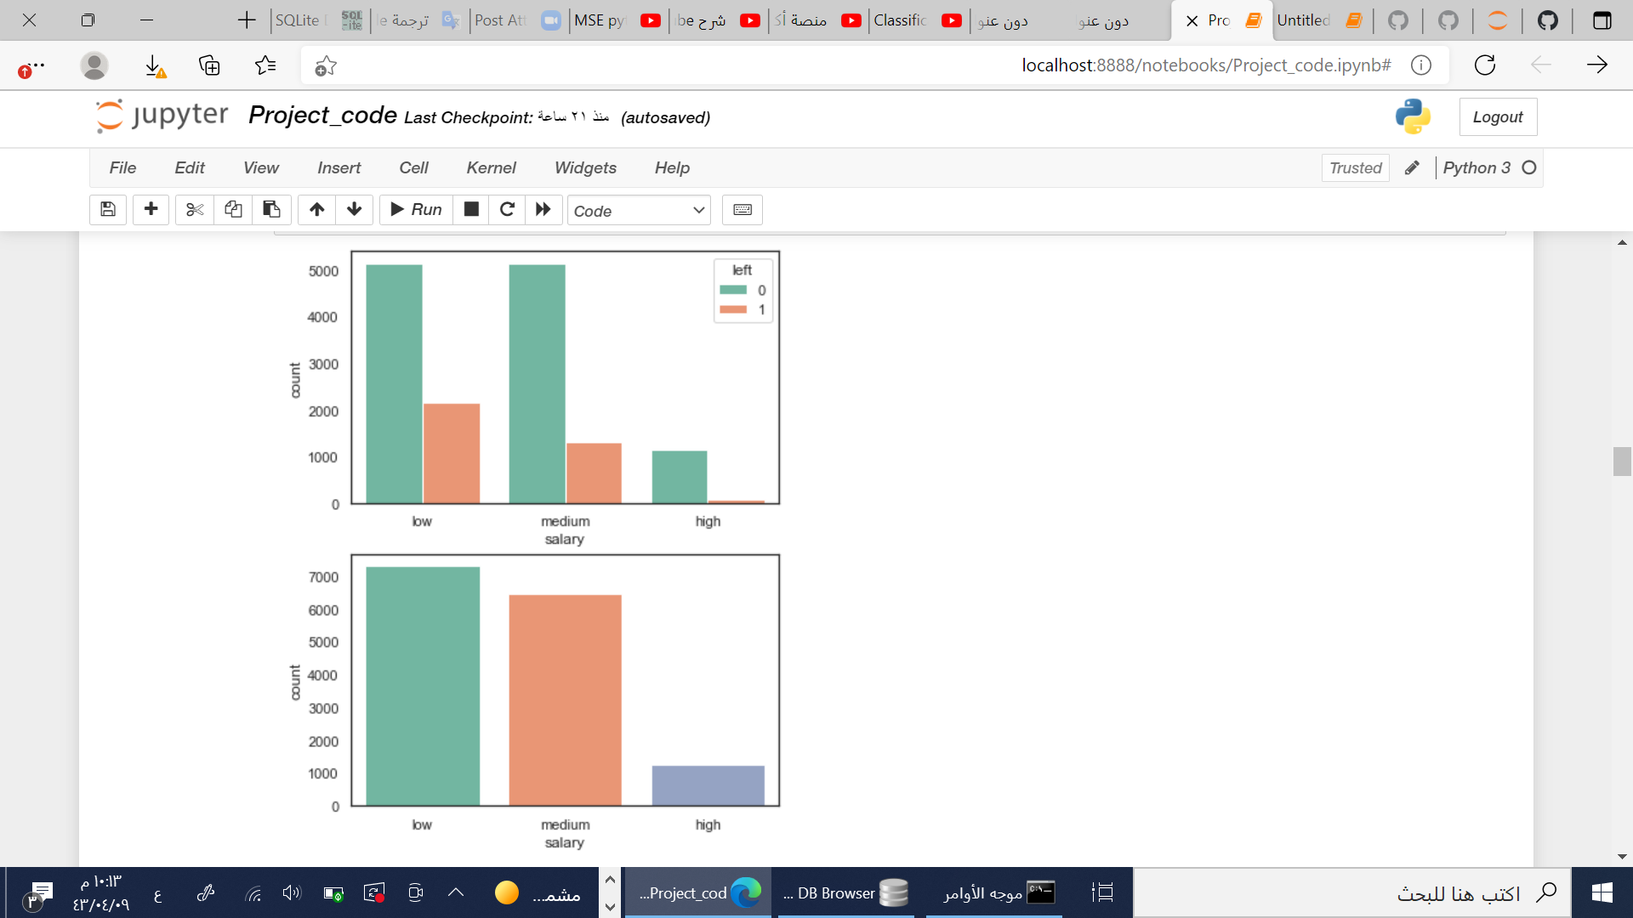
EMPLOYEES SALARY LEVEL
The left employees were receiving a low and medium level of salary

Slide 12
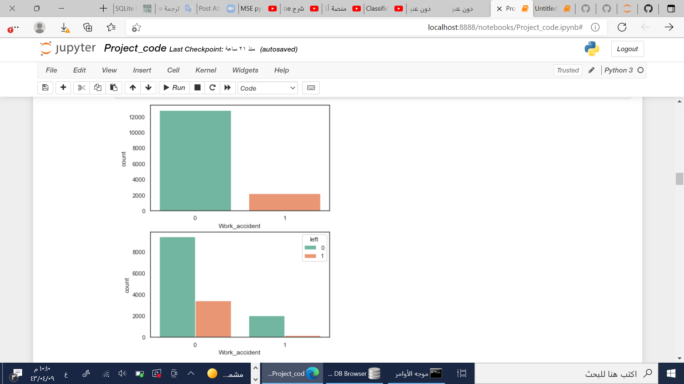
HAVE EMPLOYEES HAD A WORK ACCEDINT?
Employees they have not had workplace accident
Employees they have had workplace accident
Work accident feature not have a direct and clear impact on employees leaving

Slide 13
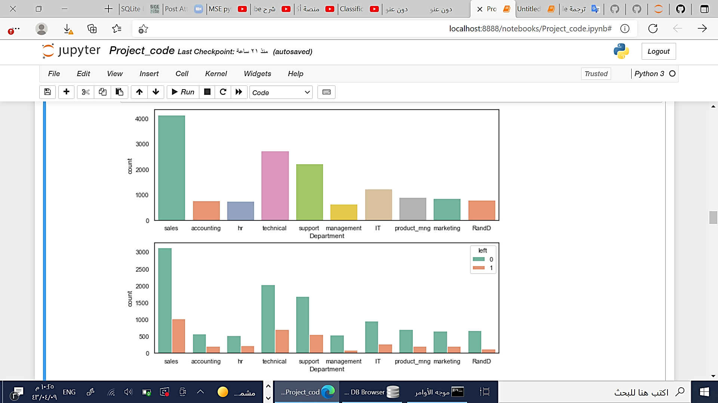
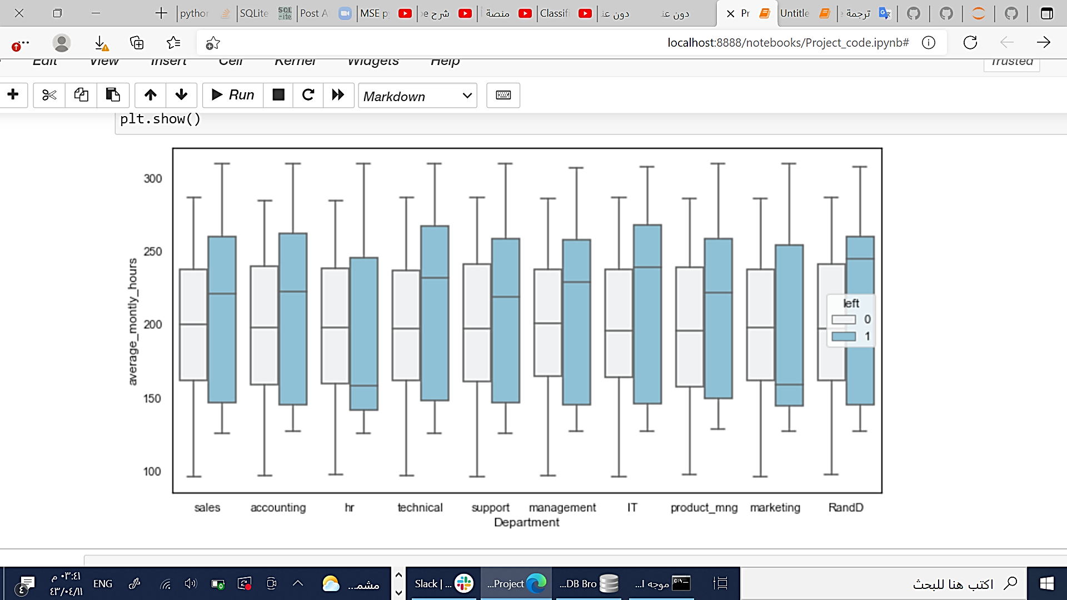
AVERAGE MONTHLY HOURS IN EACH DEPARTMENT
Count
CONTRACTED EMPLOYEE
Average_monthly_hours
LEFT EMPLOYEE
Employees who have left the organization were working for longer hours.
Department

Slide 14
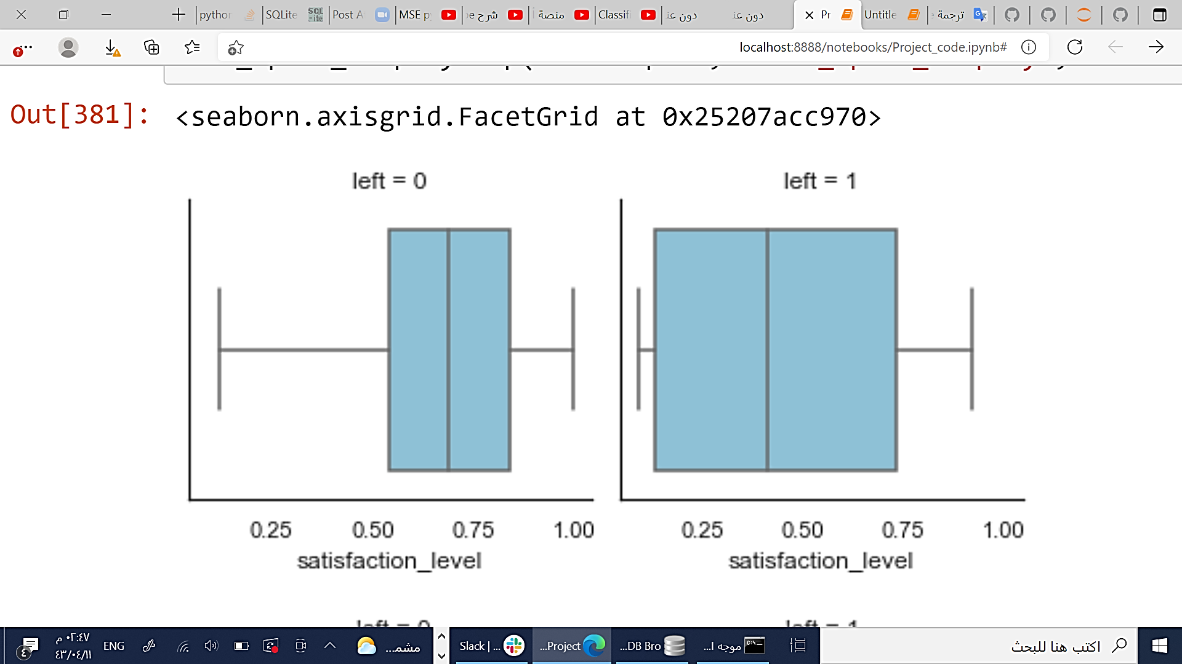
LEVEL OF EMPLOYEES SATISFACTION
Contracted employees
Left employees
Employees who are left have a lower satisfaction rate.

Slide 15
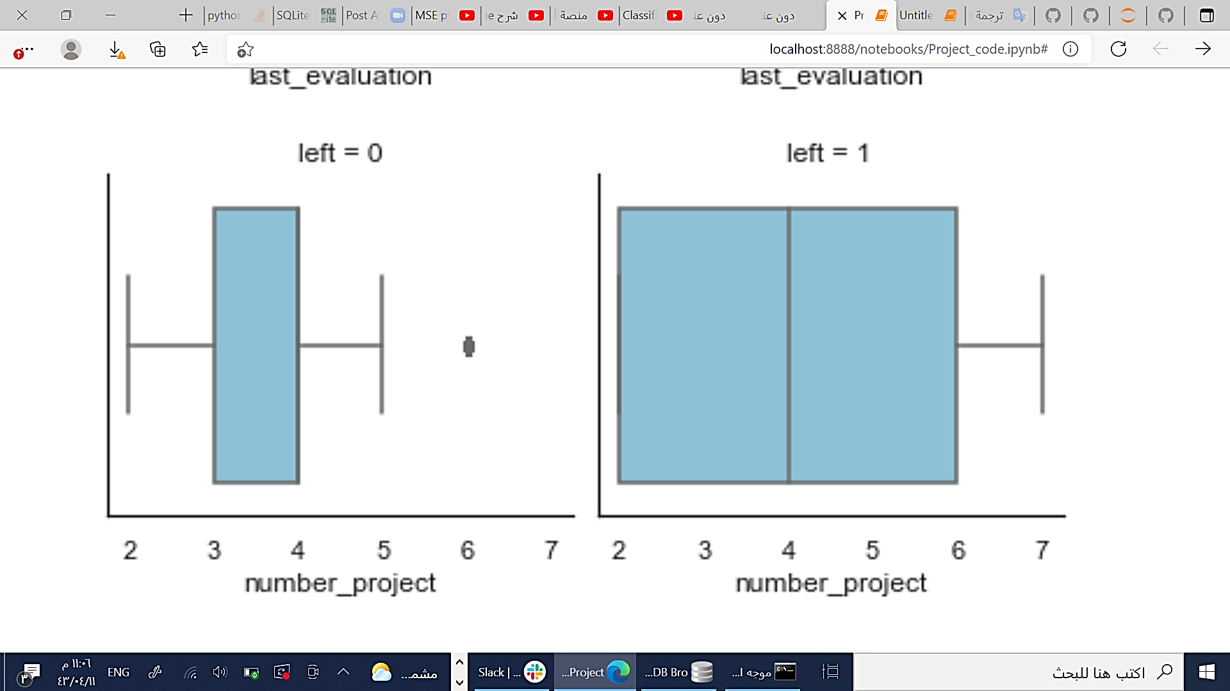
NUMBER OF PROJECTS THE EMPLOYEE COMPLETED WHILE AT WORK
Contracted employees
Left employees
Employees that handle a large amount of projects tend to leave the organization.

Slide 16
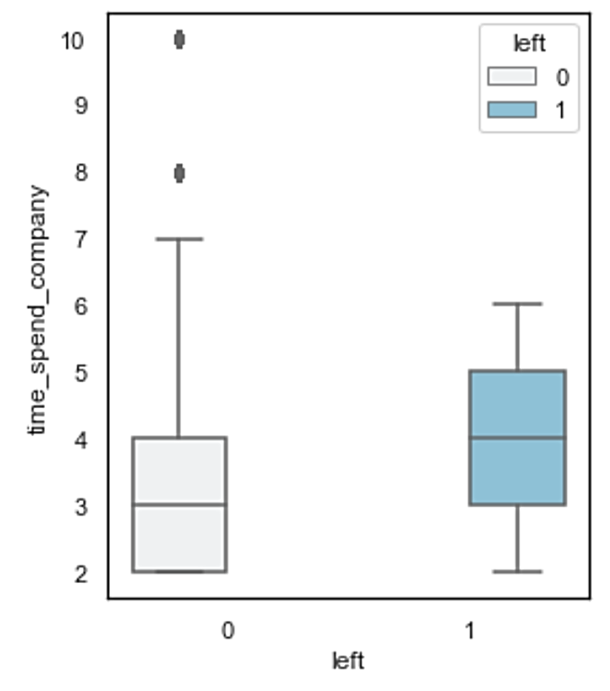
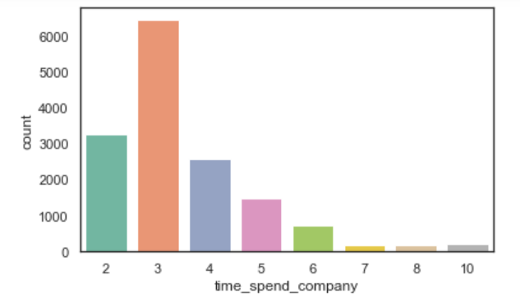
NUMBER OF YEARS THE EMPLOYEE HAS WORKED IN THE ORGANIZATION
Employees with high time employed by the organization tend to leave the organization.

Slide 17
DATA MODEL

Slide 18
LOGISTIC REGRESSION MODEL
 | Retained | left
Precision | 0.79 | 0.47
Recall | 0.92 | 0.23
F1-score | 0.85 | 0.31
KNN MODEL
 | Retained | left
Precision | 0.97 | 0.81
Recall | 0.94 | 0.90
F1-score | 0.95 | 0.85

Slide 19
ACCURACY AND MSE RESULTS
MSE | Accuracy | Model
24.2% | 75.8% | Logistic Regression
7.27% | 92.73% | KNN

Slide 20
RESOURCES
DATASET
Kaggle.com. 2021. HR Analytics. [online] Available at: <https://www.kaggle.com/giripujar/hr-analytics> [Accessed 30 October 2021].

Slide 21
THANKS!
Do you have any questions?

